Slide 1
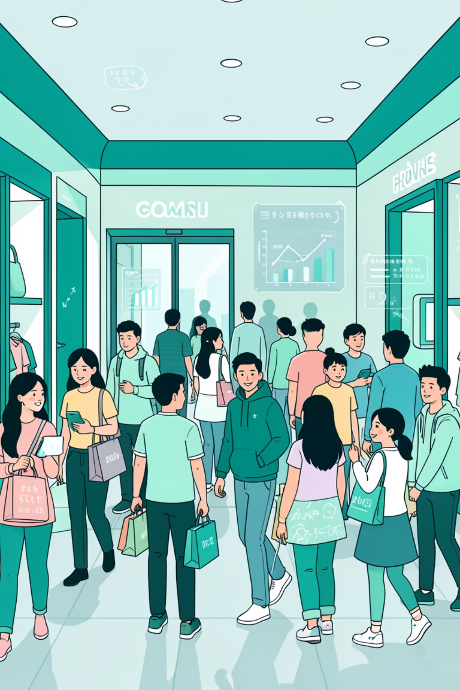
Customer Shopping Behavior Analysis
Uncovering insights from 3,900 purchases to guide strategic business decisions.

Slide 2

Project Overview & Goals
Data-Driven Insights
Analyze 3,900 purchases across categories.
Key Areas
Spending patterns, customer segments, product preferences, subscription behavior.
Strategic Decisions
Optimize operations, reduce costs, improve forecasting.

Slide 3
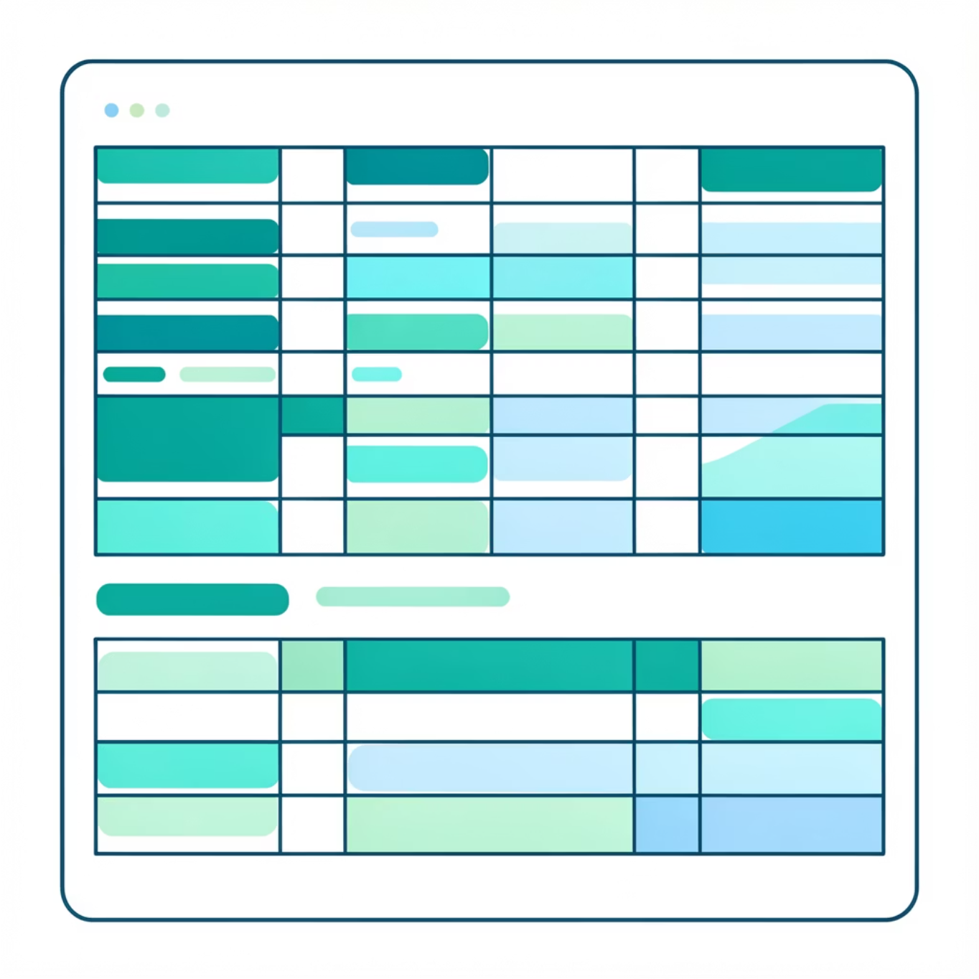

Dataset at a Glance
3.9K
18
Rows
Columns
Total purchases analyzed.
Diverse data points.
Key features include demographics, purchase details, and shopping behavior.
Missing Data: 37 values in Review Rating column.

Slide 4
Exploratory Data Analysis (Python)
01
02
Data Loading & Exploration
Data Cleaning
Imported with pandas, checked structure and summary statistics.
Imputed missing Review Ratings using median by product category.
03
04
Standardization
Feature Engineering
Renamed columns to snake case for readability.
Created age_group and purchase_frequency_days.
05
06
Consistency Check
Database Integration
Dropped redundant promo_code_used column.
Loaded cleaned data into PostgreSQL for SQL analysis.

Slide 5


SQL Analysis: Key Business Insights
Revenue by Gender
Male: $157,890, Female: $75,191.
Top 5 Products by Rating
Gloves (3.86), Sandals (3.84), Boots (3.82).
Shipping Type
Express avg. $60.48, Standard avg. $58.46.
Discount-Dependent
Hat (50%), Sneakers (49.66%), Coat (49.07%).

Slide 6
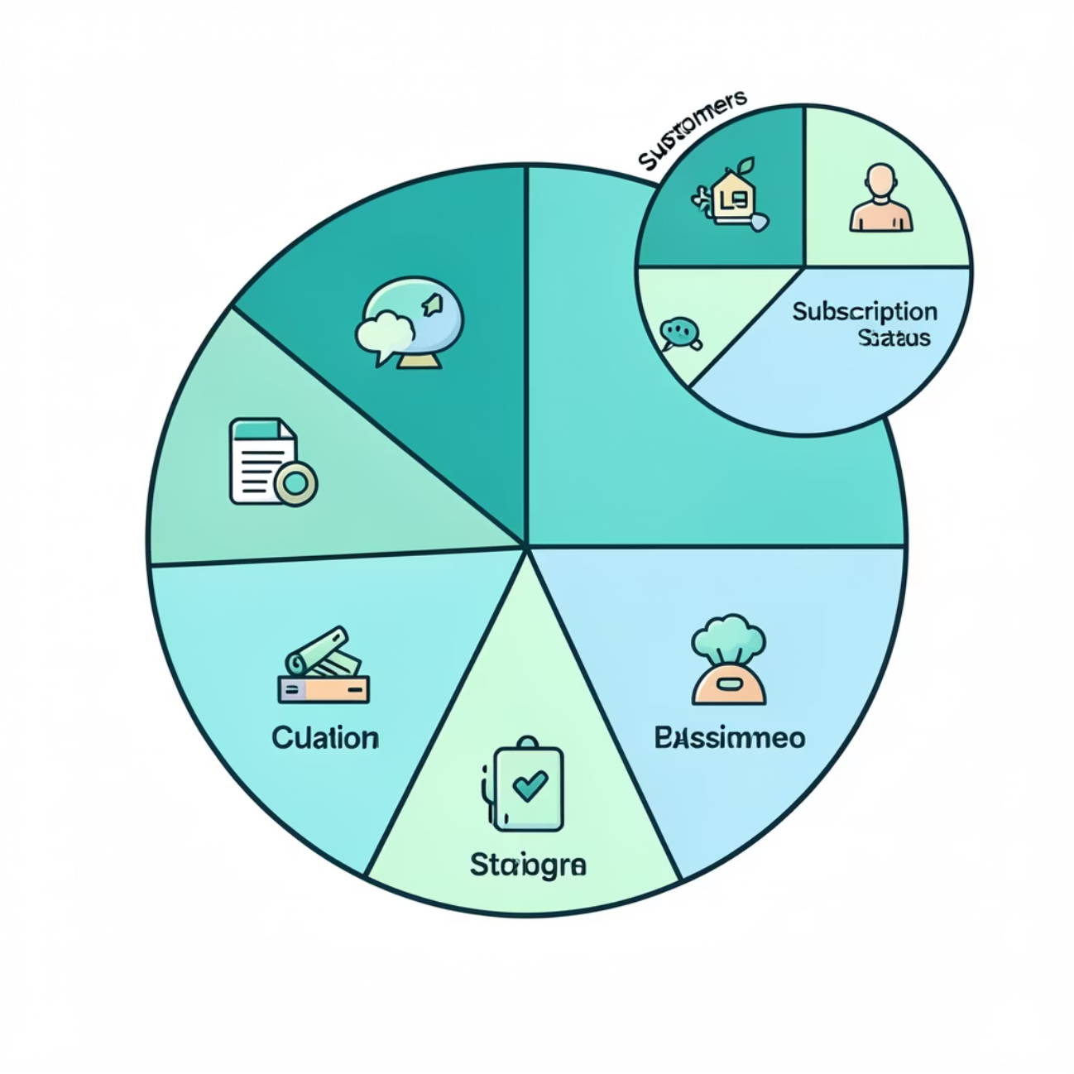
Customer Segmentation & Subscriptions
1
2
Customer Segments
Subscribers vs. Non-Subscribers
Loyal (3116), Returning (701), New (83).
Subscribers: 1053 customers, avg. spend $59.49.
3
Repeat Buyers
958 repeat buyers are subscribers.

Slide 7
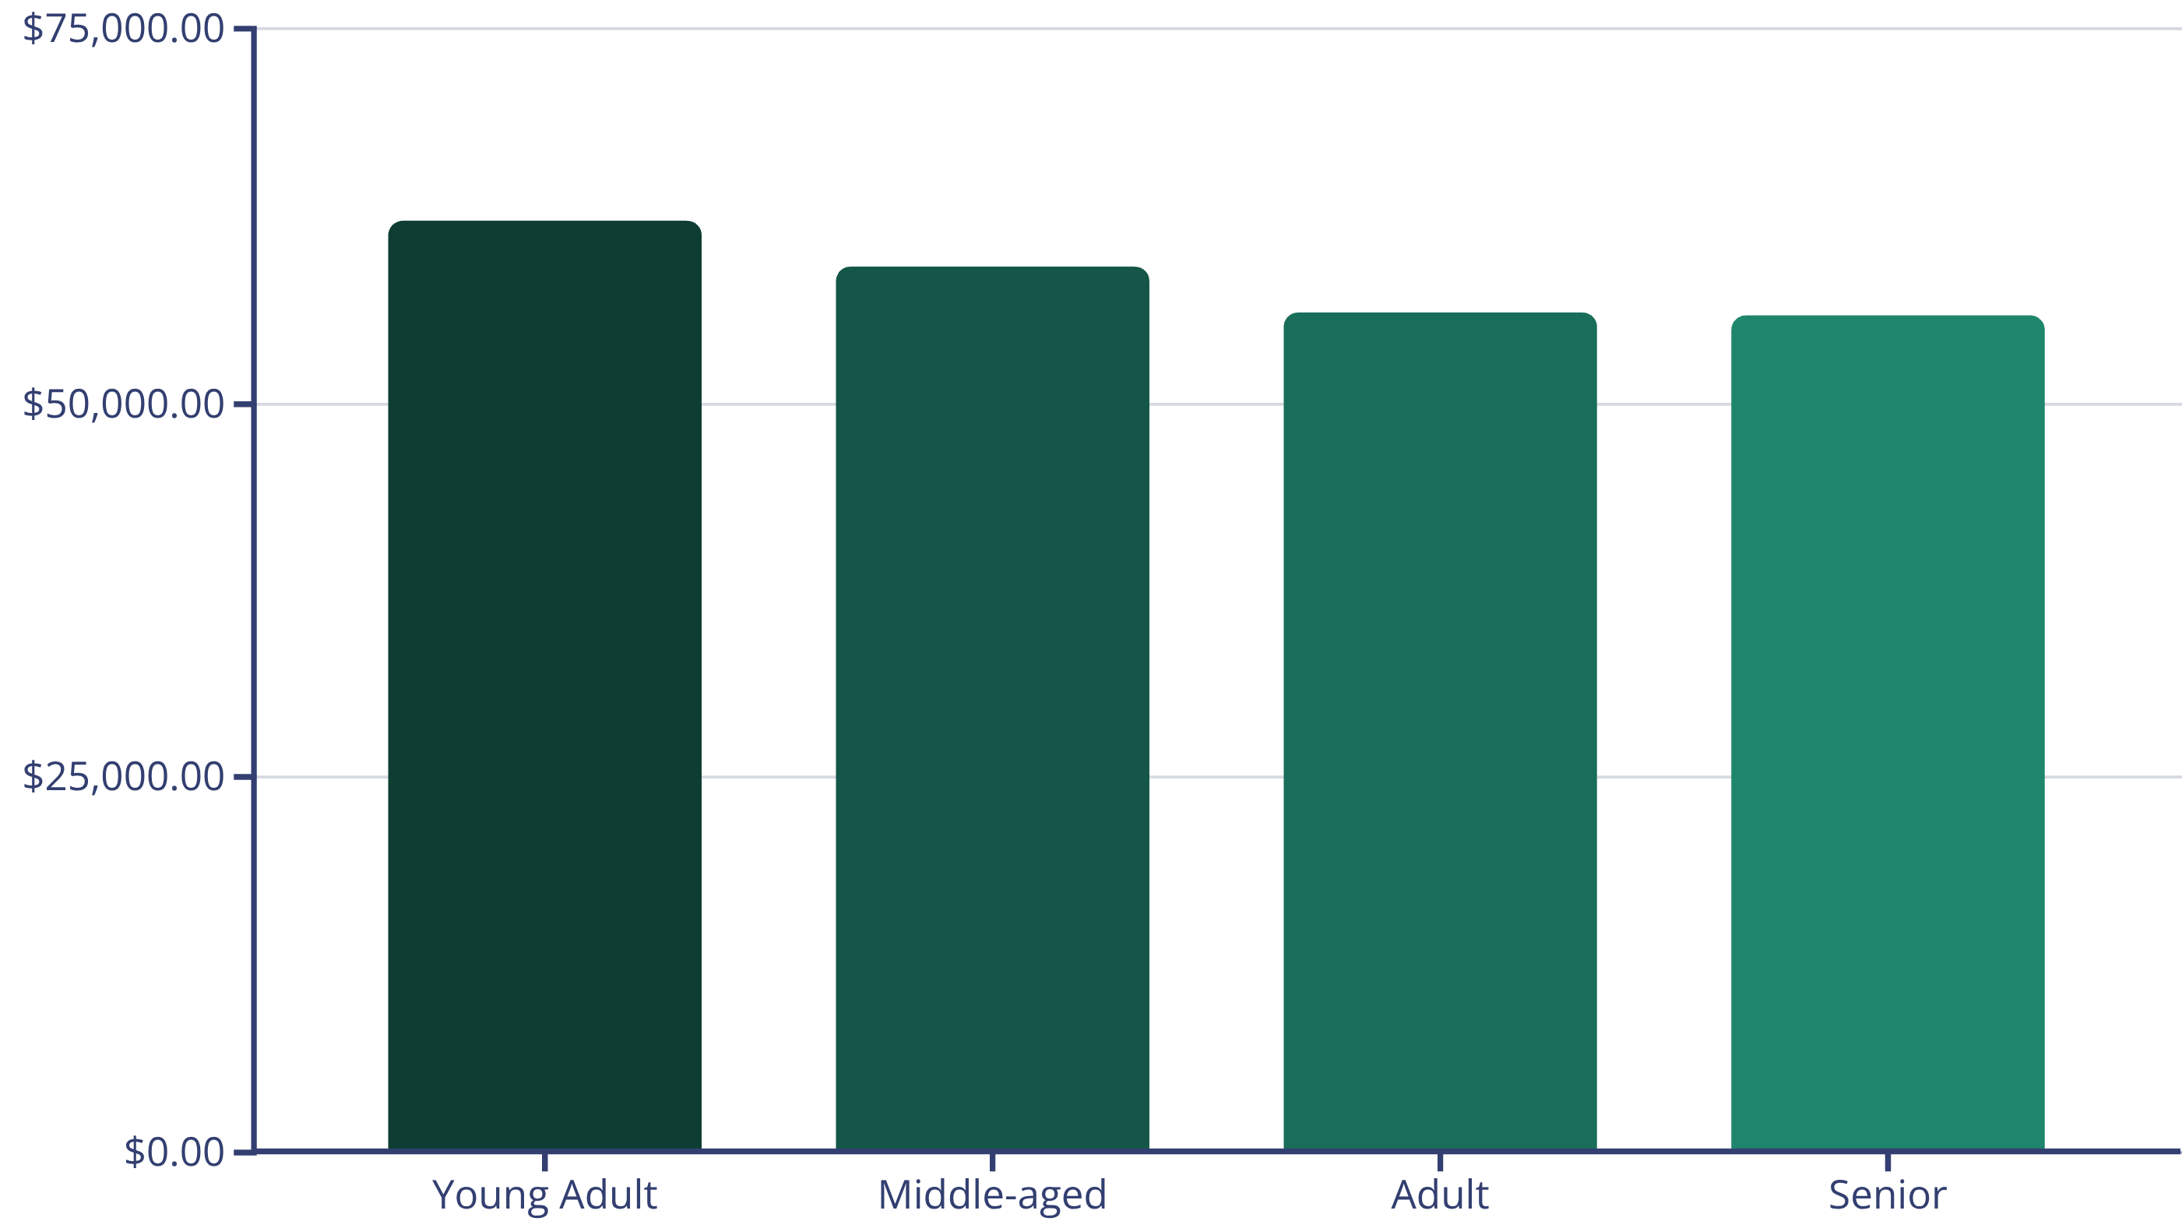
Revenue by Age Group
Young Adults contribute the highest revenue, followed closely by Middle-aged customers.

Slide 8
Top Products Per Category
1
Accessories
Jewelry
171
1
Clothing
Blouse
171
1
Footwear
Sandals
160
1
Outerwear
Jacket
163
Jewelry, Blouses, Sandals, and Jackets lead their respective categories in total orders.

Slide 9
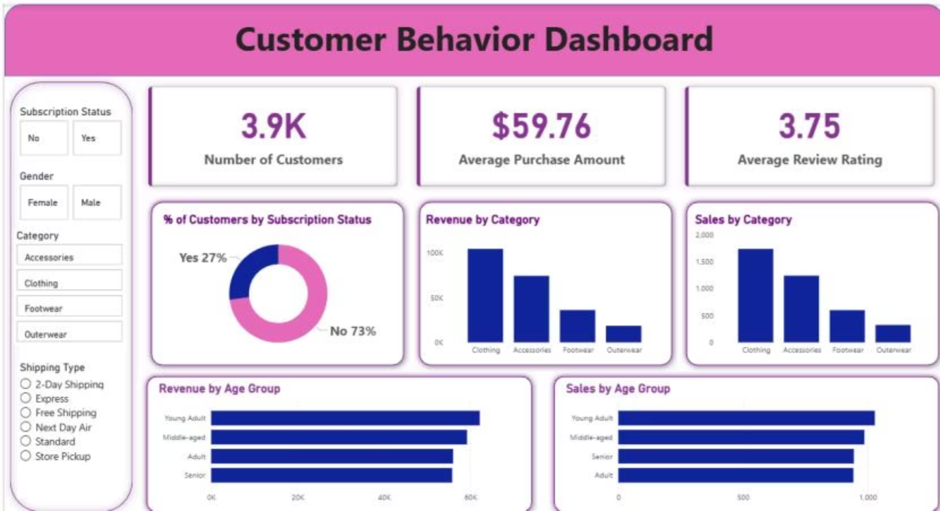
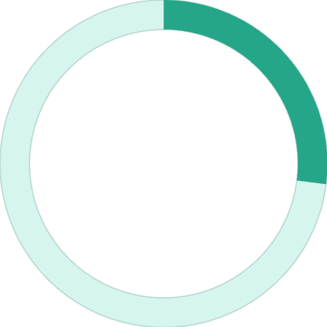
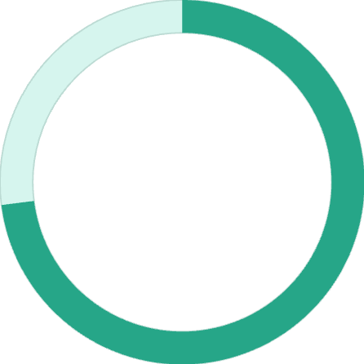
Interactive Dashboard in Power BI
~100K
Clothing Revenue
27%
~70K
Accessories Revenue
Subscribed
Customers with active subscriptions.
73%
Non-Subscribed
Customers without subscriptions.

Slide 10





Business Recommendations
Boost Subscriptions
Promote exclusive benefits for subscribers.
Customer Loyalty
Reward repeat buyers to foster loyalty.
Review Discount Policy
Balance sales boosts with margin control.
Targeted Marketing
Focus on high-revenue age groups and express-shipping users.

